Slide 1

SPRINT- 4
InternshIp group 2

Slide 2
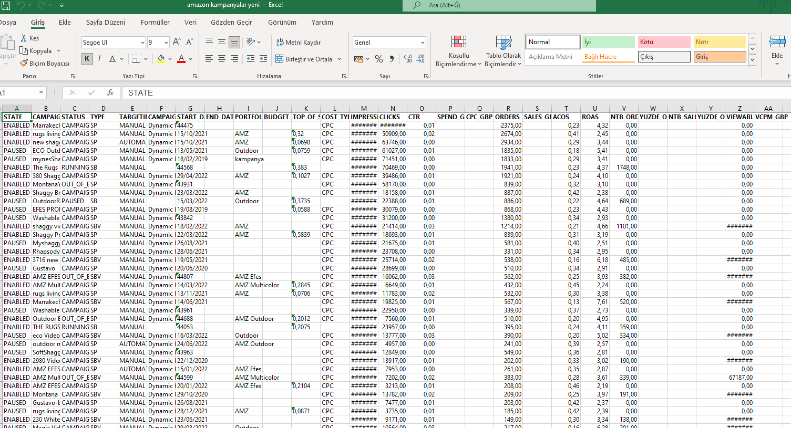
AMAZON CAMPAIGNS
On this data set, the firm had send it out to analyze Amazon Campaigns.
In this table, there are few metrics which require domain knowledge.

Slide 3
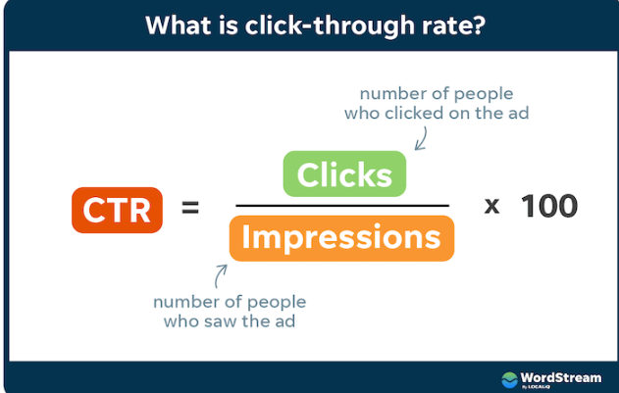
1. TOP 5 CTR of the Compaigns

Slide 4
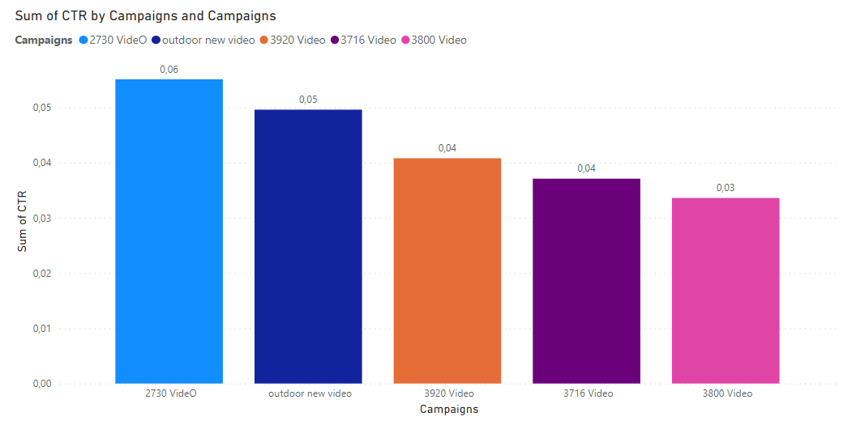
TOP 5 CTR of the Compaigns

Slide 5
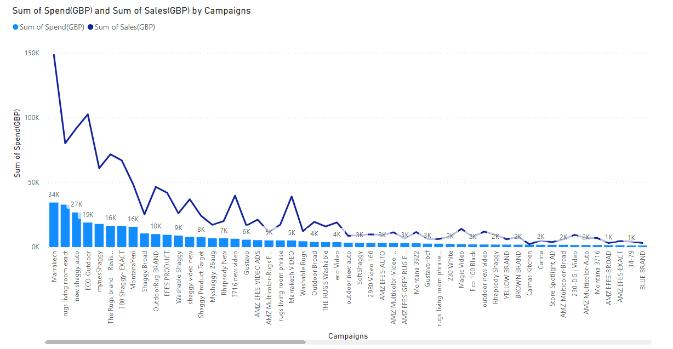
2) The relation between Spend and Sales

Slide 6
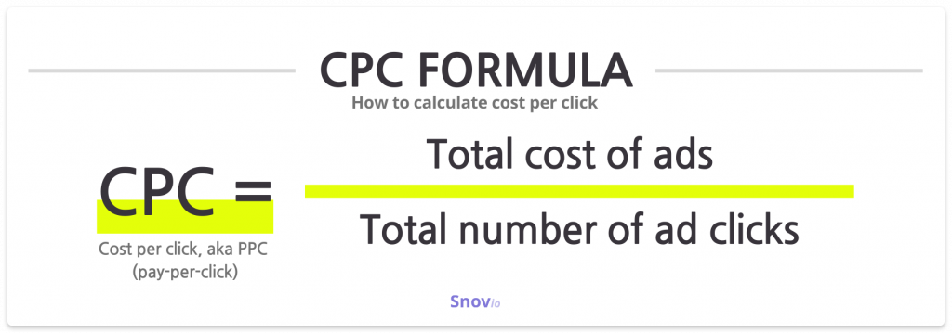
3)The Relation between CPC and Income

Slide 7
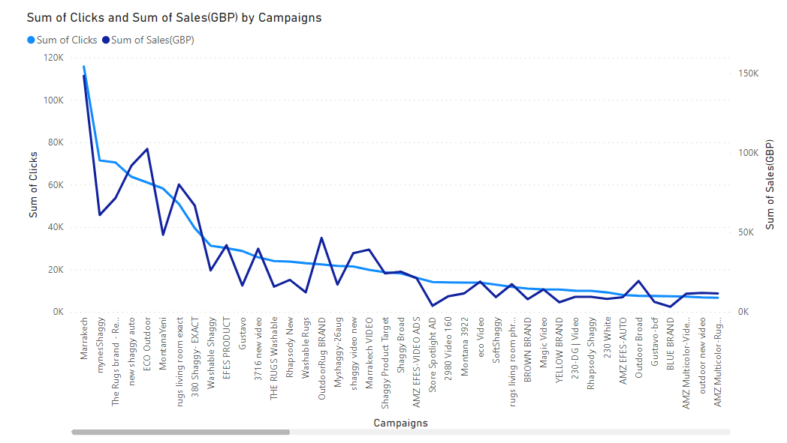
The Relation between CPC and Income

Slide 8
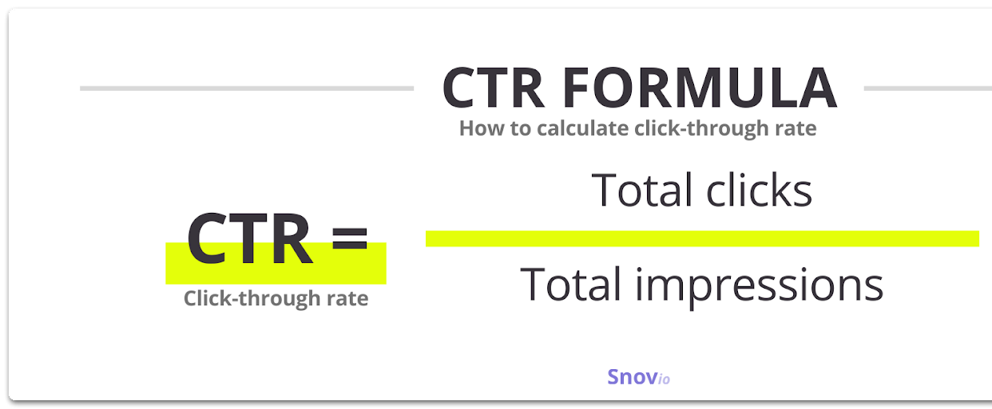
4)The Relation between CTR and Sales(GBP)

Slide 9
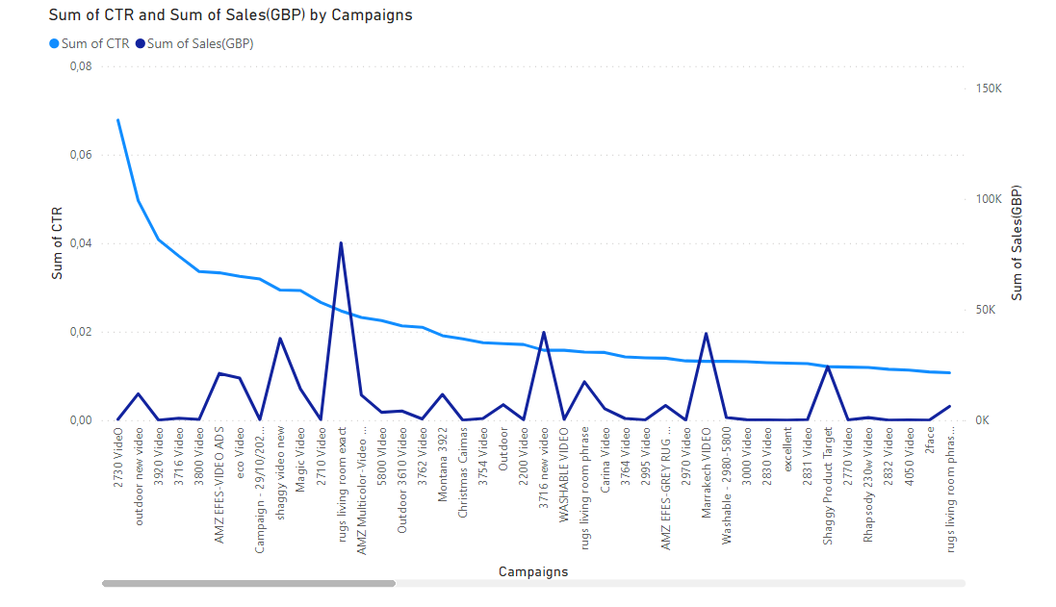
The Relation between CTR and Sales(GBP)

Slide 10
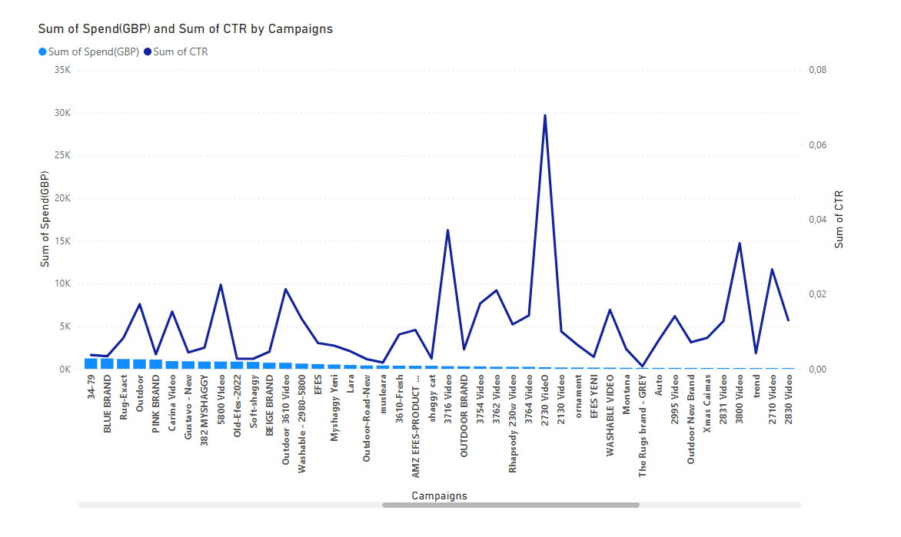
5)The relation between Spent(GBP) and CTR(clicks)

Slide 11
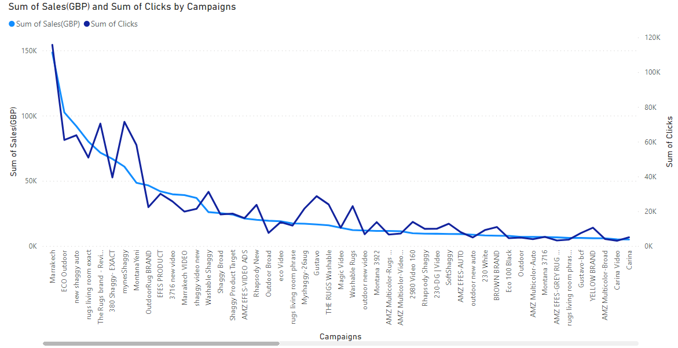
6)The Relation between Sales(GBP) and Clicks

Slide 12
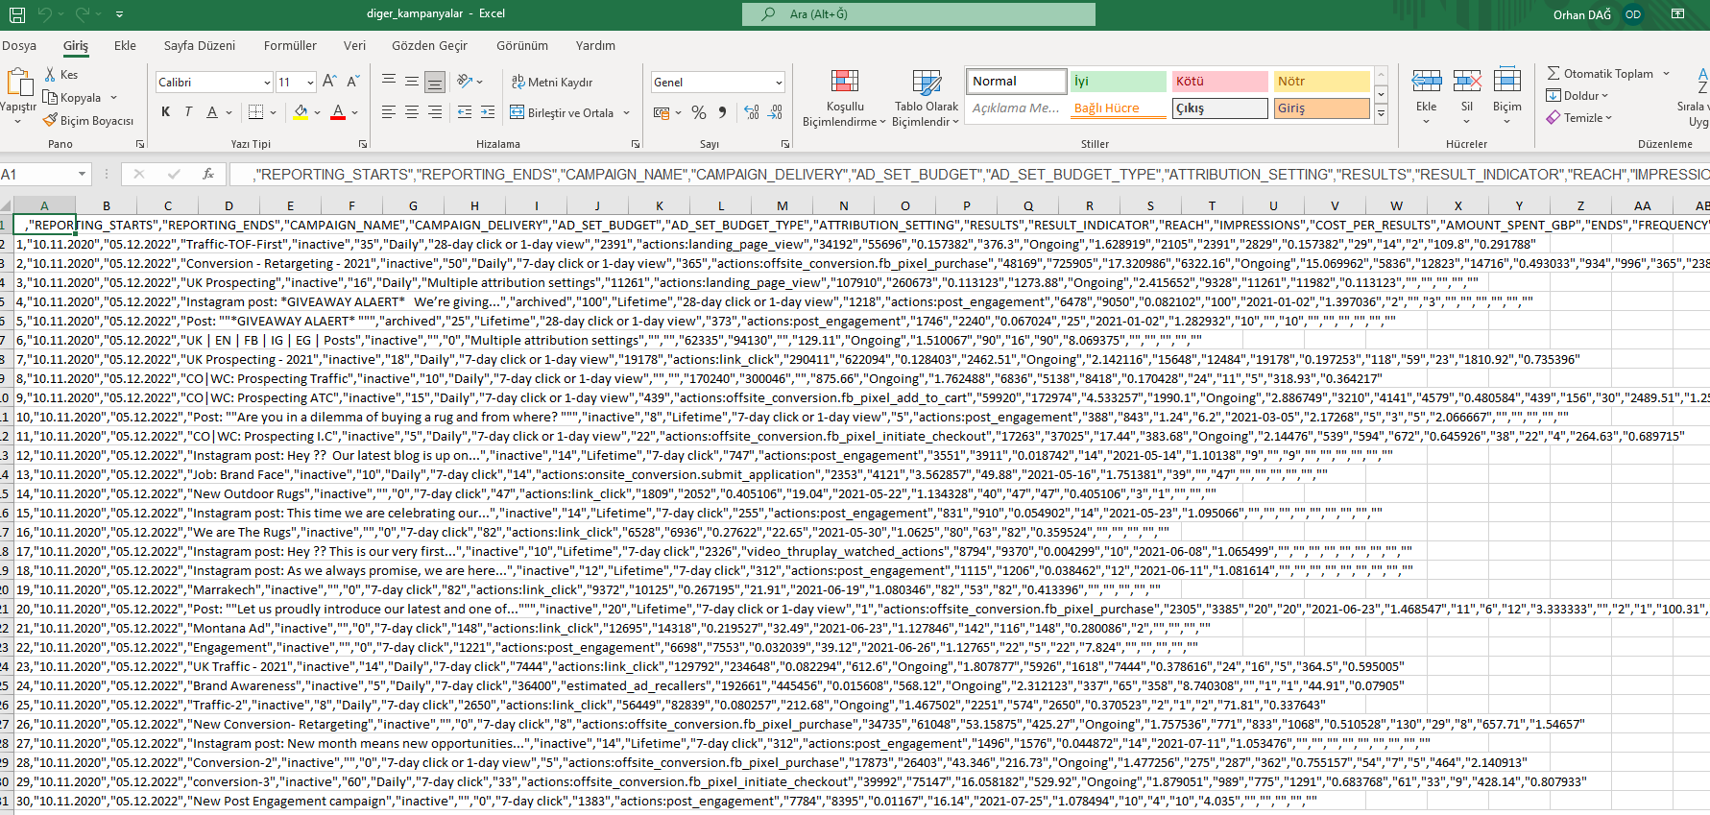
Other Campaigns
In this table we examined the campaigns of the firm on Facebook.

Slide 13
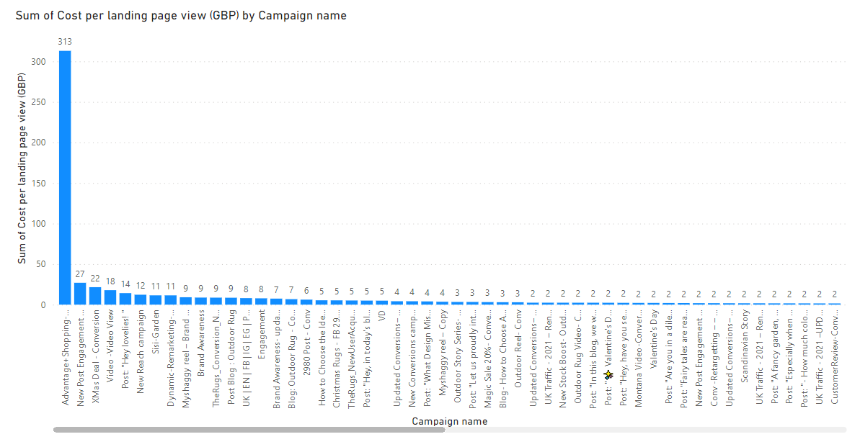
1)Total Cost per Landing Page View

Slide 14
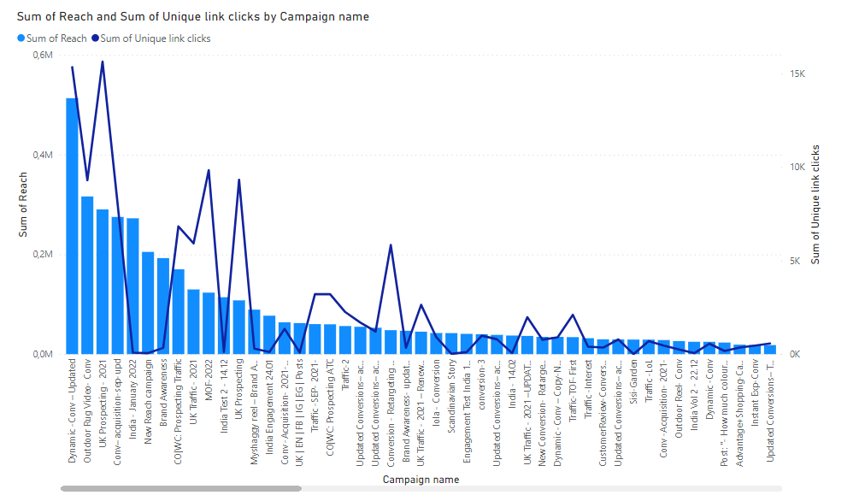
2)Reach and Unique Link Clicks (A/B)

Slide 15
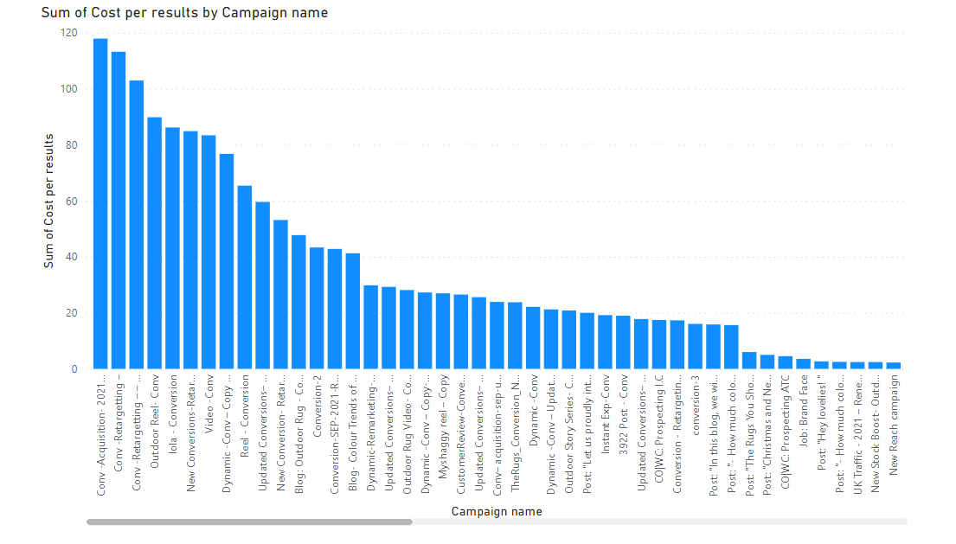
3)Cost per Results

Slide 16
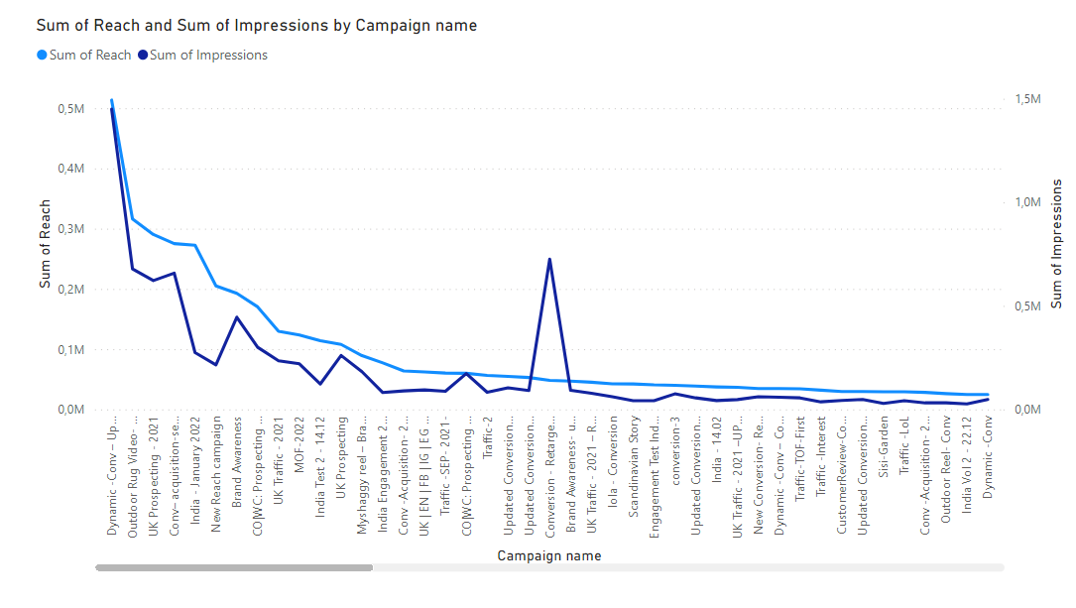
4)Reach and Impression(A/B)

Slide 17
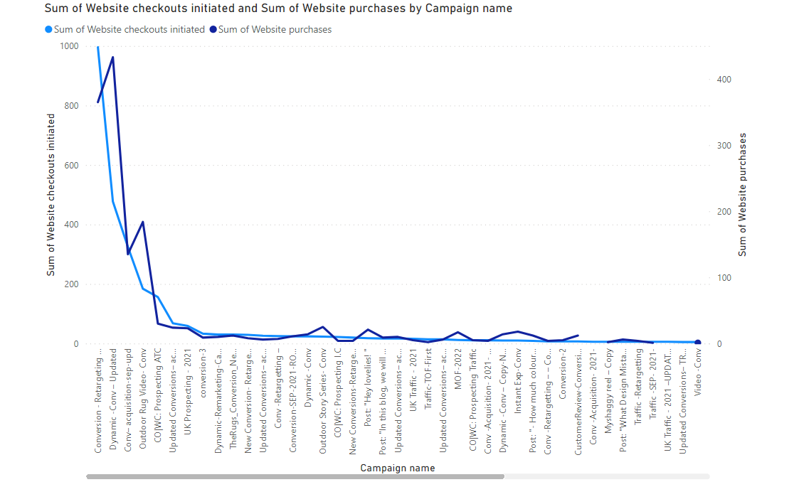
5)Check-outs and Purchase

